Slide 1
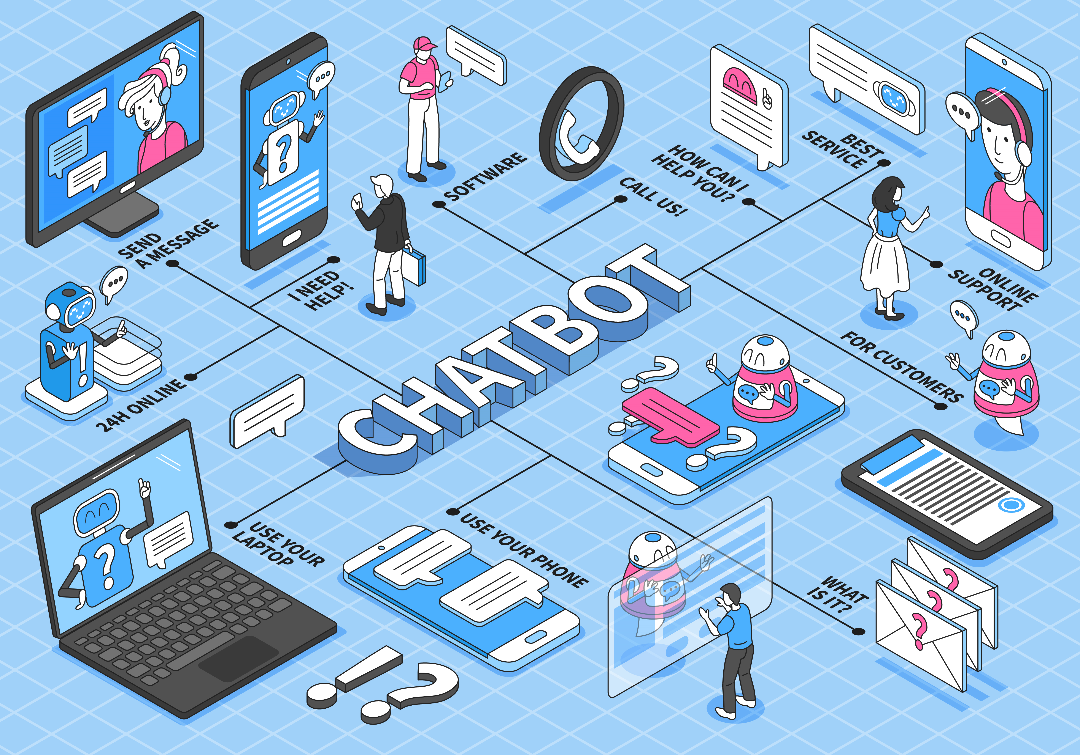
An AI-powered system for patient monitoring and chat bot

Slide 2
What is chat bot ?
A chatbot is a computer program designed to simulate conversation with human users, especially over the Internet. Chatbots can be integrated into messaging platforms, mobile apps, or websites to provide quick, automated customer support or information on a wide range of topics. They use natural language processing and machine learning algorithms to understand and generate responses to user requests.

Slide 3
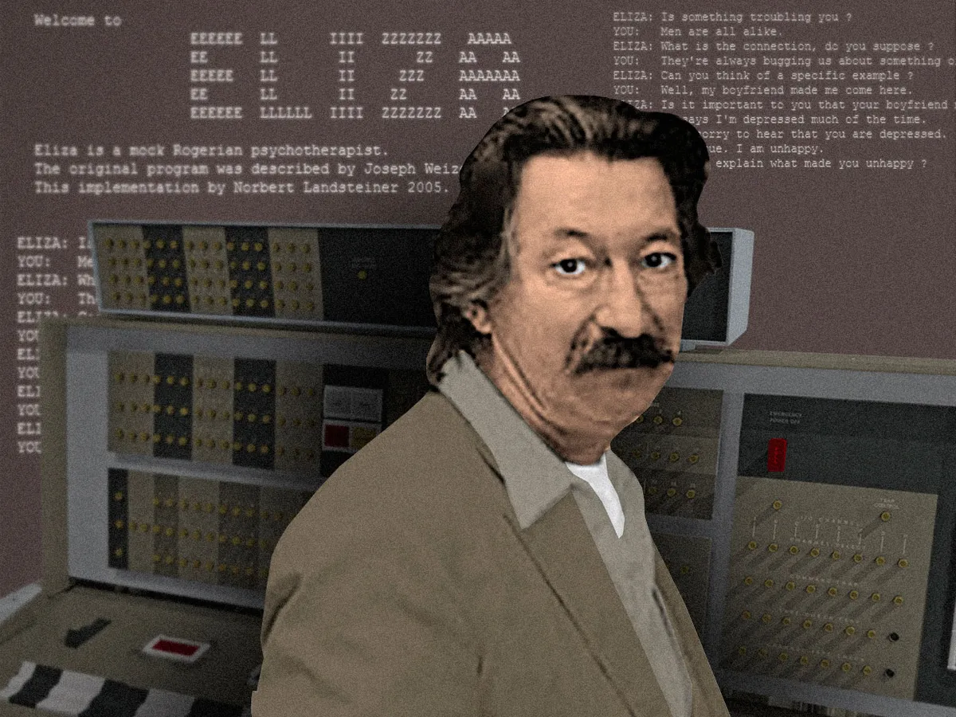
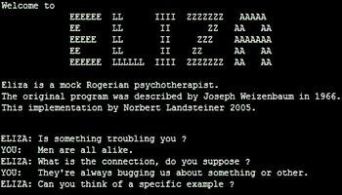
Who invented chatbot ?
The invention of chatbots is credited to a computer scientist Joseph Weizenbaum, who created the first chatbot program ELIZA in 1966.

Slide 4
chat bot in ai
Chatbot is a computer program designed to simulate conversation with human users, especially over the Internet. AI (Artificial Intelligence) technology can be used to build chatbots that can understand natural language inputs and respond with relevant information or actions. AI chatbots can also learn from interactions with users and continuously improve their conversational abilities.

Slide 5
Use’s of chat bot
Chatbots are used in a variety of industries and applications to automate tasks, improve customer experience, and save time and resources. Some common uses of chatbots include:
1.Customer Service: Chatbots can assist customers by answering frequently asked questions, resolving issues, and directing them to the right person or resource.
2.Sales: Chatbots can provide product recommendations, answer questions, and guide customers through the purchasing process.
3.Marketing: Chatbots can be used to engage with customers, deliver personalized promotions and offers, and gather data and insights.
4.Healthcare: Chatbots can assist patients by answering health-related questions, scheduling appointments, and providing information on medications and treatments.

Slide 6
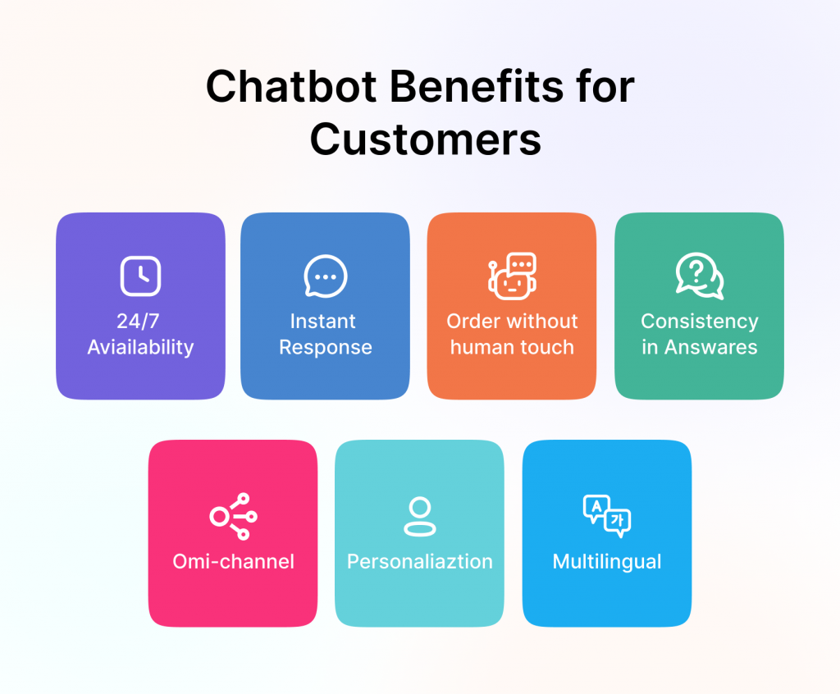
5.Finance: Chatbots can help customers manage their finances, provide investment advice, and answer questions about their accounts.
6.Education: Chatbots can assist students by answering questions, providing study materials, and tracking progress.
7.Entertainment: Chatbots can provide recommendations for movies, music, and other forms of entertainment, and engage in casual conversations with users.

Slide 7
Use’s of chat bot in ai
Chatbots are AI-powered software programs that can interact with people in a conversational manner.
They are used in a variety of applications, including customer service, sales, marketing, and entertainment.
Chatbots can help automate repetitive tasks, answer questions, provide recommendations, and perform various other functions, saving time and improving the overall customer experience.

Slide 8
How does chat bot used in ai
Chatbots are typically used in AI through natural language processing (NLP) and machine learning (ML) technologies.
1.NLP: The chatbot uses NLP algorithms to understand and interpret human language, allowing it to respond to questions and commands in a conversational way.
2.ML: The chatbot is trained using ML algorithms to improve its responses over time. This training can be done using data sets or by observing and learning from human interactions with the chatbot.
3.Rule-based systems: Some chatbots use pre-defined rules and decision trees to determine the appropriate response to a user's input.
4.Self-learning systems: More advanced chatbots use deep learning algorithms to continually improve their responses and decision-making abilities based on past interactions.

Slide 9
Requirements to create chat bot
1.Data Collection: The first step is to gather a large dataset of symptoms, conditions, and related information. This data could come from medical journals, websites, and other sources.
2.Data Pre-processing: The next step is to pre-process the data to ensure that it is in a format that can be used by deep learning algorithms. This might involve converting unstructured data into structured data, removing duplicates and irrelevant information, and normalizing the data.
3.Model Training: Once the data is pre-processed, it can be used to train a deep learning model. This could be a recurrent neural network (RNN) or a transformer network, depending on the requirements of the specific use case. The model should be trained using a large sample of data and validated using a smaller sample to check its accuracy.
4.Chatbot Interface: The next step is to design the chatbot interface, which should allow users to input symptoms and receive relevant information and triage recommendations. This interface should be user-friendly and easy to use.
5.Deployment: The final step is to deploy the chatbot, which could involve integrating it into a website, app, or other platform. The chatbot should be tested thoroughly before deployment to ensure that it is functioning correctly and providing accurate results.

Slide 10
what is First aid ?
First aid is the first and immediate assistance given to any person with either a minor or serious illness or injury, with care provided to preserve life, prevent the condition from worsening, or to promote recovery.
First aid is the initial assistance provided to a person who has been injured or suddenly taken ill.
The primary goal of first aid is to preserve life, prevent further harm, and promote recovery.
The basic principles of first aid include the following:
1. Assess the situation: Before providing first aid, it is essential to assess the situation and ensure that it is safe for both you and the person in need.
2.Call for help: If the person is seriously injured, call for professional medical help immediately.
3.Provide comfort: Stay with the person and provide comfort, support, and reassurance while waiting for medical help.

Slide 11
4.Check for breathing: If the person is not breathing, begin cardiopulmonary resuscitation (CPR) immediately.
5.Control bleeding: If the person is bleeding, apply pressure to the wound with a clean cloth or bandage.
6.Treat for shock: If the person is in shock, lie them down, elevate their feet, and cover them with a blanket to keep them warm.
7.Treat burns: If the person has a burn, cool the affected area with cold water or a cold compress.
8.Treat fractures: If the person has a suspected fracture, immobilize the affected limb with a splint or sling.
9.Administer medications: If the person has medication with them, assist them in taking it if necessary.

Slide 12
uses of ai in first aid
1.Chatbots and virtual assistants: AI-powered chatbots and virtual assistants can be used to provide immediate guidance to people who need first aid. These tools can ask relevant questions to assess the situation and provide step-by-step instructions on what to do until medical help arrives.
2.Predictive analytics: AI can be used to analyze data from medical emergency calls to predict the likelihood of certain types of emergencies happening in different areas. This can help emergency services to be better prepared and allocate resources more efficiently.

Slide 13
3.Image analysis: AI can be used to analyze images from cameras or drones to identify potential hazards or dangers in emergency situations, such as identifying the location of victims in natural disasters.
4.Diagnosis and triage: AI can assist medical professionals in diagnosing and triaging patients in emergency departments by analyzing data from medical devices and electronic health records.
5.Medical decision-making: AI can assist medical professionals in making decisions about treatment options by analyzing data from medical tests and suggesting the best course of action.
6.Personalized first aid: AI can be used to provide personalized first aid advice based on an individual's medical history, current health status, and environmental factors.

Slide 14
how can we use the first aid chat bot ?
First aid chatbots are a useful tool for providing immediate guidance and assistance to people who need first aid. Here are the steps you can follow to use a first aid chatbot:
1.Find a reliable first aid chatbot: There are several first aid chatbots available online, so make sure you find a reliable one that is developed by a reputable organization.
2.Access the chatbot: You can access the chatbot through various platforms, including messaging apps, websites, and social media platforms.

Slide 15
3.Provide details about the situation: The chatbot will ask you questions about the situation, such as the type of injury or illness, the severity of the symptoms, and any other relevant information.
4.Follow the instructions: Based on the information you provide, the chatbot will provide step-by-step instructions on what to do until medical help arrives. Follow the instructions carefully and ask for clarification if needed.
5.Seek medical help if necessary: If the chatbot advises you to seek medical help or if the situation is serious, call for professional medical assistance immediately.

Slide 16
Example code for creating chat bot
# Import necessary libraries
import os
import dialogflow_v2 as dialogflow
from google.api_core.exceptions import InvalidArgument
# Set up authentication for Dialogflow
os.environ["GOOGLE_APPLICATION_CREDENTIALS"] = "path/to/credentials.json"
project_id = "your-project-id"
session_id = "your-session-id"

Slide 17
language_code = "en"
# Define the function to detect intent from user input
def detect_intent(text):
session_client = dialogflow.SessionsClient()
session = session_client.session_path(project_id, session_id)
text_input = dialogflow.types.TextInput(text=text, language_code=language_code)
query_input = dialogflow.types.QueryInput(text=text_input)
try:
response = session_client.detect_intent(session=session, query_input=query_input)
except InvalidArgument:
response = None
if response:
return response.query_result.fulfillment_text
else:
return "I'm sorry, I didn't understand. Can you please try again?"
# Define the main function to start the conversation
def main():
print("Hi! I'm a chatbot. How can I help you today?")
while True:

Slide 18
message = input("You: ")
if message.lower() == "bye":
print("Bot: Goodbye!")
break
else:
response = detect_intent(message)
print("Bot: " + response)
# Call the main function
if __name__ == "__main__":
main()

Slide 19
Software used to create the chat bot
Dialogflow
Microsoft Bot Framework
IBM Watson Assistant
ChatterBot
Botpress
Rasa
Pandorabots

